Slide 1
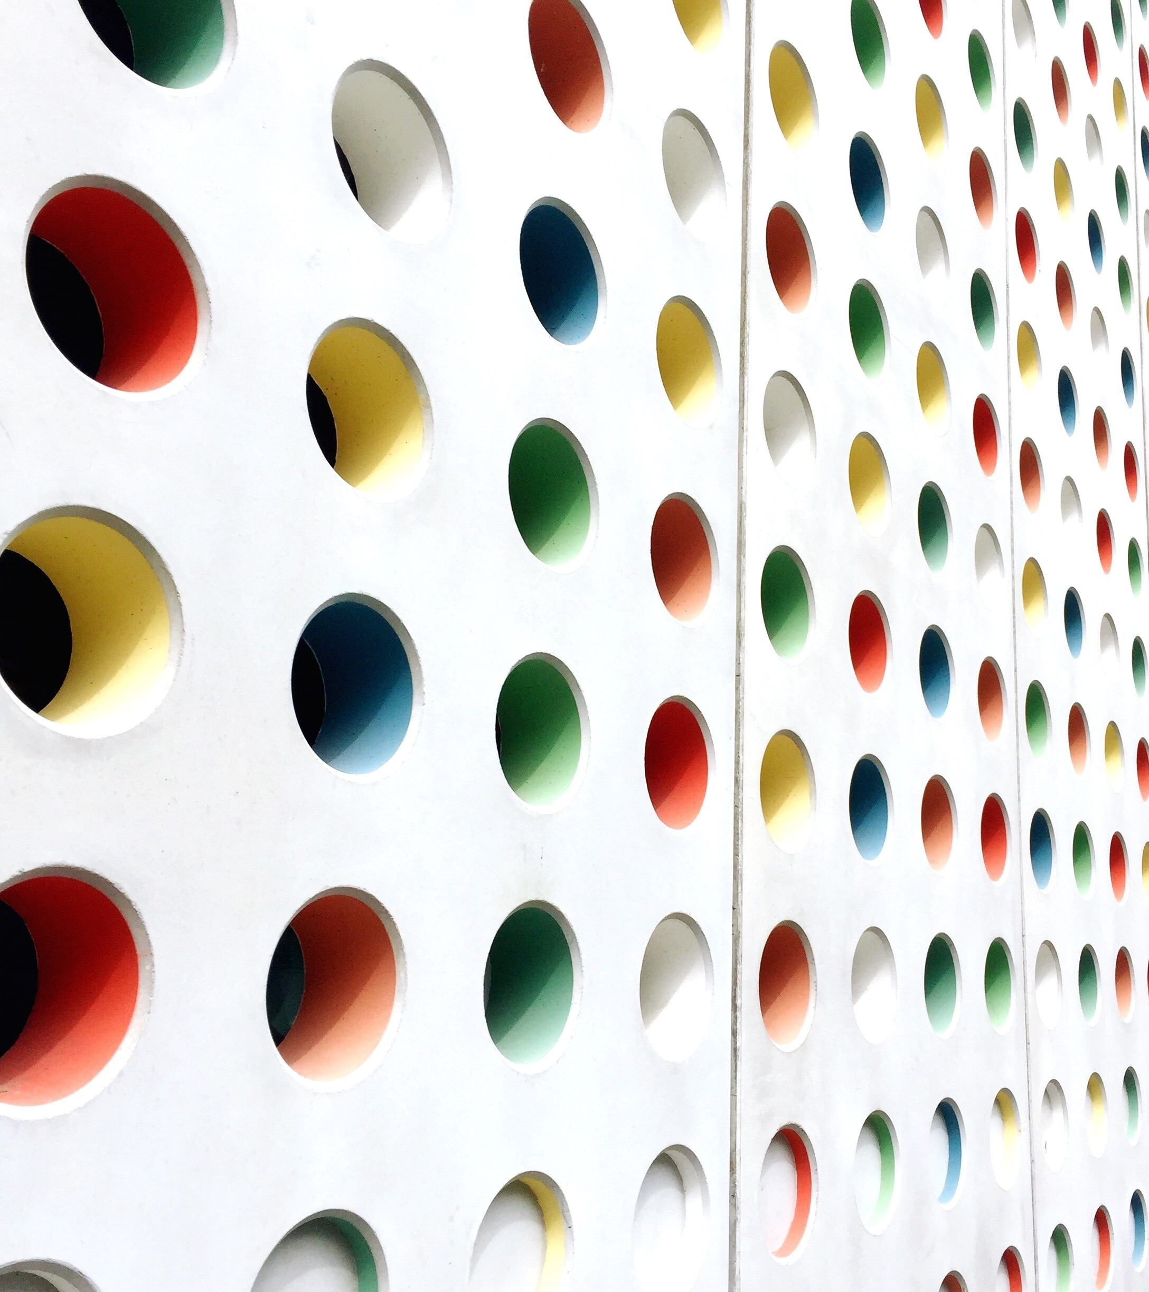
Technical Security Architecture
A flight over the cuckoo’s nest

Slide 2
What are we looking at? (when flying high over the cuckoo’s nest)
What is it?
Where do we start?
What do we look for?
Evidence!!!
More evidence!!!
Drawings

Slide 3
What IS IT? (non-pretentious definition)
An overview of the technical decisions in order to give a direction and implement the high-level plan (architecture) to secure the enterprise
It should align with the security policies of the company (if there are any)
It should ne measurable
AND
It should be measurable in an automated way ;)

Slide 4
Where do we start? (..somewhere in the middle..)
It is always good to understand what is already in place
(procedures, enterprise architecture, security policies, technical setup)
And what is important for the particular business
And how far they are prepared to go within the next months and year (to prioritize)
Be aware you cannot fix everything!

Slide 5
What do we look for? (here come the cis controls)
A very good to tough all domains is to follow the CIS controls (https://www.cisecurity.org/controls/cis-controls-list/)
All the domains covered in the controls should be identifiable in the technical architecture
Some controls will be incomplete but compensated by others. That is the technical architecture will include the overall enterprise security strategy, and not define isolated approaches
There should be a red thread towards achievable targets (do not aim to do more than realistic possible –> prefer quality over quantity)
Start with solid base principles (eg basic CIS controls).
Fancy approaches in an environment where the basis are missing are not going to work

Slide 6
What do we look for? (an architectural process)
Togaf (https://www.opengroup.org/togaf)/ Sabsa (https://sabsa.org/)
Almost always Togaf/ sometimes Sabsa. Mostly as Sabsa is much more detailed and increases exponential the costs for a correct implementation https://sabsa.org/sabsa-executive-summary/
A mature enterprise security-wise would make sense using Sabsa.
Most enterprises: not. It would get too complex, expensive and would take too long to implement
Togaf: cyclic method to measure and improve security in a controlled way

Slide 7
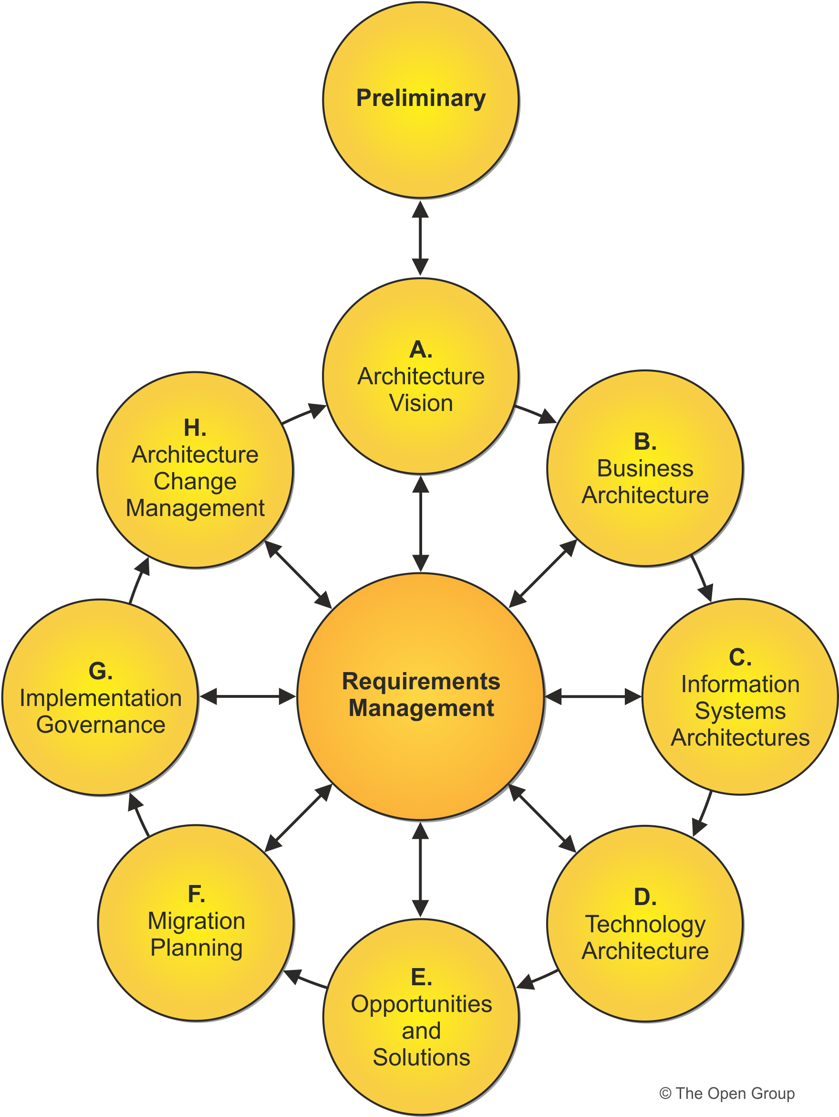
togaf (an overview)
Offers the possibility to make smaller but qualitative steps
Technical architecture needs to help the overall enterprise security
Prioritize the steps which can make the highest impact on the most important domains
Review yearly (or more often if progress allows it)
Define clear projects as results of the principles described
Monitor the quality and realization of these projects
Don’t forget the principle of automation ;)

Slide 8
evidence (measure it)
The technical architecture should include the process of measuring the implemented security controls in the defined projects
Never design something which cannot be measured
Measuring a security solution should be included in the project when possible
It helps in the next (Togaf) iteration if the decision can be made based on evidence
Example: let us look at the email migration from on-site to cloud which would increase flexibility, ‘outsource’ the setup security. If the reports for the year before show exceeding malware incidents sourced by emails attachment, then we need compensating controls like sandboxing, host security, other malware filters at the network or cloud level.

Slide 9
More evidence (measure it … again)
Measure all the technical controls after each major change caused by projects
(major projects can be a result of a Togaf/Sabsa cyclical architecture approach)
The measurements should be done used automated controls (tooling, scripts)
Results should be recorded and used in correlations and reporting

Slide 10
drawings (because *almost* no one is reading the text)
Most people do not read long text
Or attention goes away after few minutes
But drawings remain as reference
Try to illustrate complex approaches with drawings
Try to know your audience

Slide 11
Example 1 addressing the malware problem

Slide 12
Example 2 policies – they apply to all solutions equally

Slide 13
So many … questions !?!
After a very high-level flight over

